Slide 1
Data Communication & Networks

Slide 2
Data Communications
Data communications are the exchange of data between two devices via some form of transmission medium such as a wire cable.

Slide 3
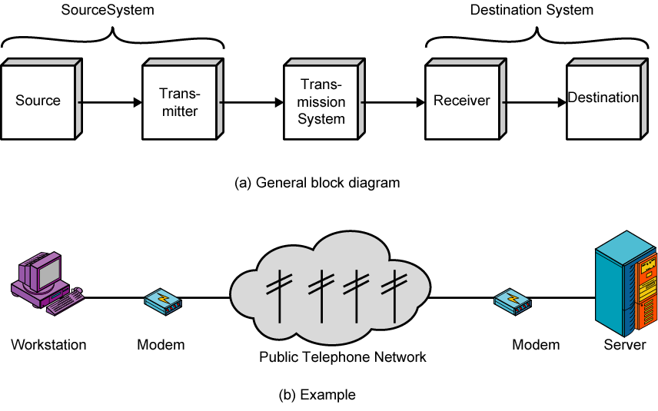
Simplified Communications Model - Diagram

Slide 4
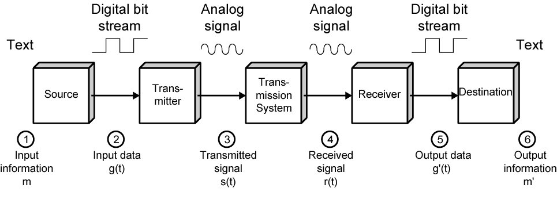
Simplified Data Communications Model

Slide 5
Fundamental Characteristics
The effectiveness of a data communication system depend on four fundamental characteristics:
  Delivery
  Accuracy
  Timelines
  Jitter

Slide 6
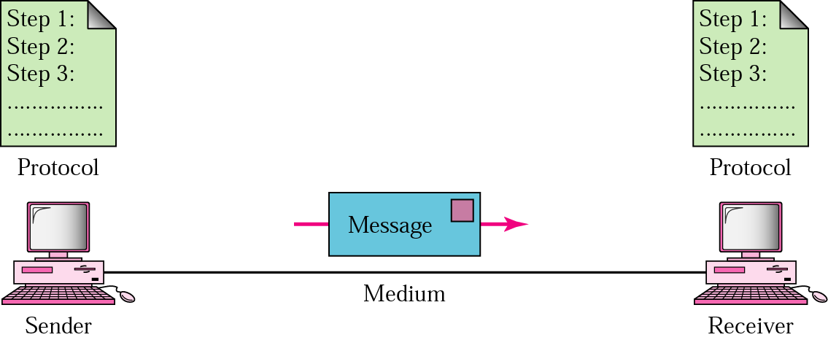
Five Components of Data Communication
Message
Sender
Receiver
Medium
Protocol

Slide 7
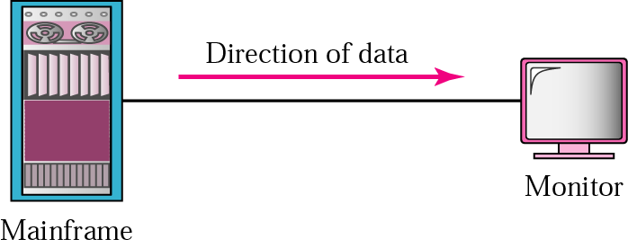


Direction of data flow
Simplex
Half Duplex
Full Duplex

Slide 8
Networks: key issues
Network criteria
  Performance
    Throughput
    Delay
  Reliability
    Data transmitted are identical to data received.
    Measured by the frequency of failure
    The time it takes a link to recover from a failure
  Security
    Protecting data from unauthorized access

Slide 9
Terminology
The throughput or bandwidth of a channel is the number of bits it can transfer per second
The latency or delay of a channel is the time that elapses between sending information and the earliest possible reception of it

Slide 10
Network topologies
Topology defines the way hosts are connected to the network

Slide 11
Network topology issues
a goal of any topology
high throughput (bandwidth)
low latency

Slide 12
Bandwidth and Latency
Bandwidth
1. telecommunications: range of radio frequencies: a range of radio frequencies used in radio or telecommunications transmission and reception
2. computing: communications capacity: the capacity of a communications channel, for example, a connection to the Internet, often measured in bits per second
3. a data transmission rate; the maximum amount of information (bits/second) that can be transmitted along a channel
Latency
A synonym for delay, is an expression of how much time it takes for transmission from one designated point to another

Slide 13

Categories of Topology

Slide 14
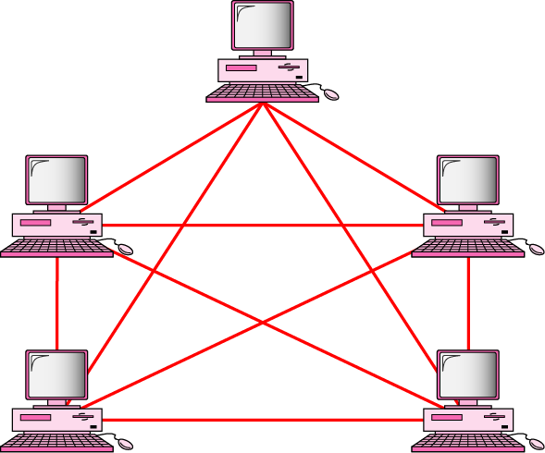
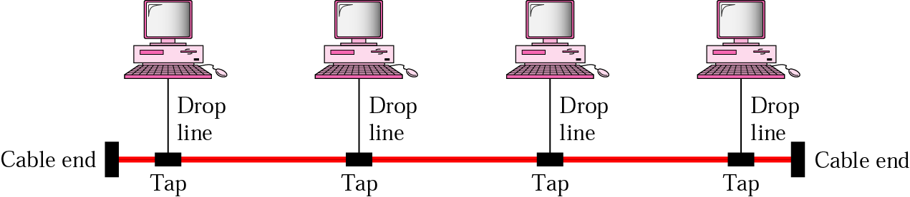
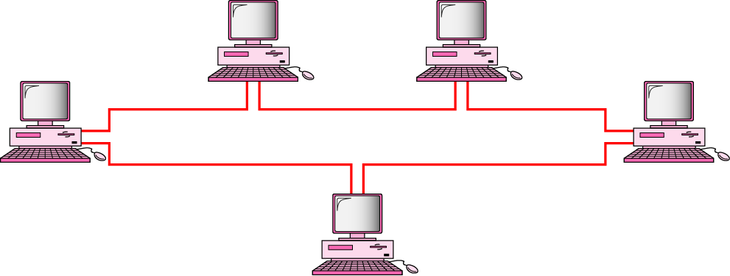
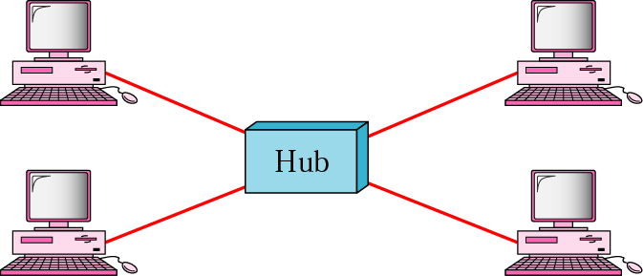
Mostly used network topologies
bus
mesh
ring
star

Slide 15

A hybrid topology: a star backbone with three bus networks

Slide 16

Hierarchical organization of the Internet

Slide 17
Layering & Protocol Stacks

Slide 18
What’s a protocol?
human protocols:
“what’s the time?”
“I have a question”
introductions
… specific msgs sent
… specific actions taken when msgs received, or other events
network protocols:
machines rather than humans
all communication activity in Internet governed by protocols

Slide 19



Protocol
protocols define format, order of msgs sent and received among network entities, and actions taken on msg transmission, receipt
a human protocol and a computer network protocol:
time
Hi
TCP connection
req.
Hi
TCP connection
reply.
Got the
time?
Get http://gaia.cs.umass.edu/index.htm
2:00
<file>

Slide 20
Standard
Essential in creating and maintaining an open and competitive market for equipment manufacturers
Guaranteeing national & international interoperability of data & telecommunication technology & process.

Slide 21
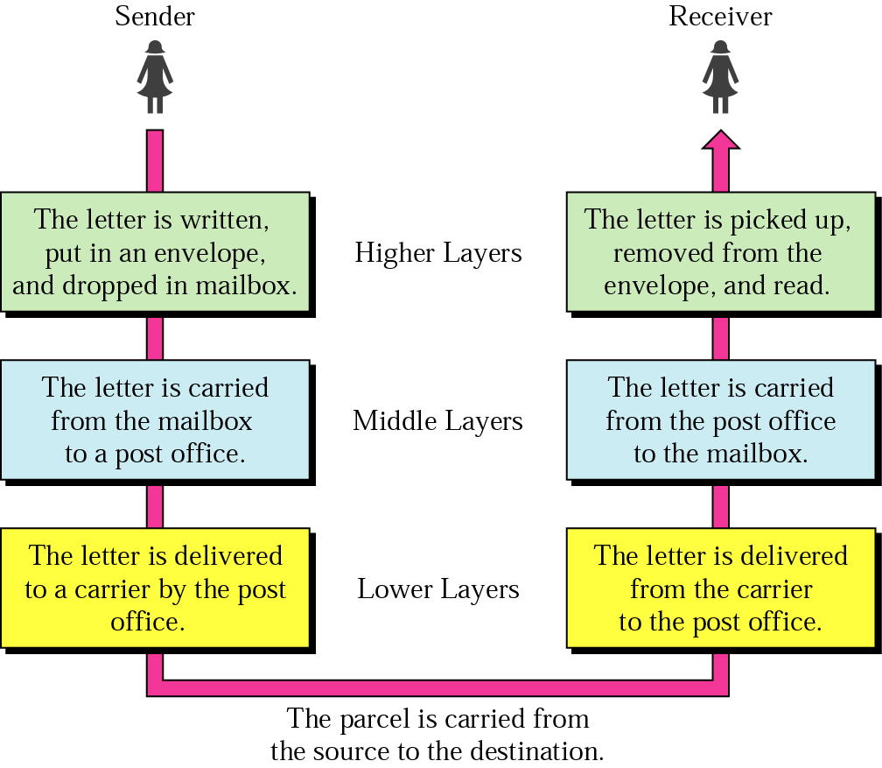




Layered Tasks
An example from the everyday life
Hierarchy?
Services

Slide 22
Why layered communication?
To reduce complexity of communication task by splitting it into several layered small tasks
Functionality of the layers can be changed as long as the service provided to the layer above stays unchanged
  makes easier maintenance & updating
Each layer has its own task
Each layer has its own protocol

Slide 23
Reference Models
OSI reference model
TCP/IP

Slide 24
OSI Reference model
Open System Interconnection
7 layers
Crate a layer when different abstraction is needed
Each layer performs a well define function
Functions of the layers chosen taking internationally standardized protocols
Number of layers – large enough to avoid complexity

Slide 25

Seven layers of the OSI model

Slide 26

Exchange using OSI Model

Slide 27

The interaction between layers in the OSI model

Slide 28
Issues, to be resolved by the layers
Larger bandwidth at lower cost
Error correction
Flow control
Addressing
Multiplexing
Naming
Congestion control
Mobility
Routing
Fragmentation
Security
....

Slide 29
OSI Layers

Slide 30
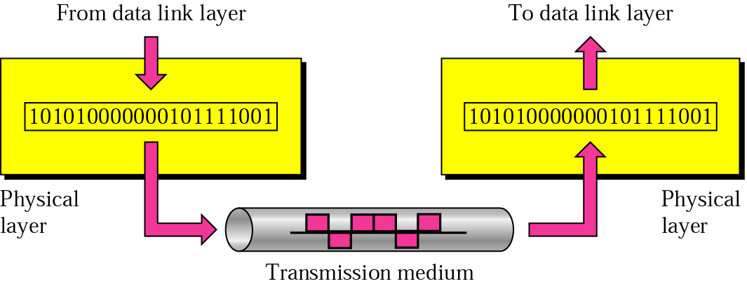
Physical layer
physical
connection
Transporting bits from one end node to the next
type of the transmission media (twisted-pair, coax, optical fiber, air)
bit representation (voltage levels of logical values)
data rate (speed)
synchronization of bits (time synchronization)

Slide 31

Note
The physical layer is responsible for movements of
individual bits from one hop (node) to the next.

Slide 32
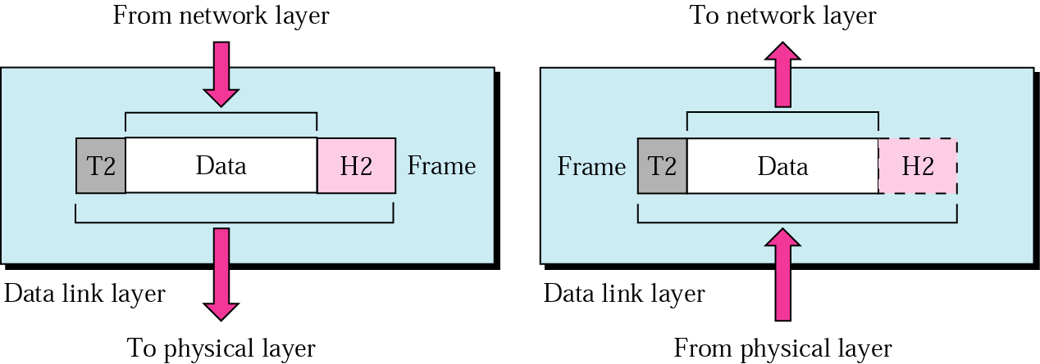
Data Link layer
logical
connection
Transporting frames from one end node to the next one
- framing - physical addressing
- flow control - error control
access control

Slide 33
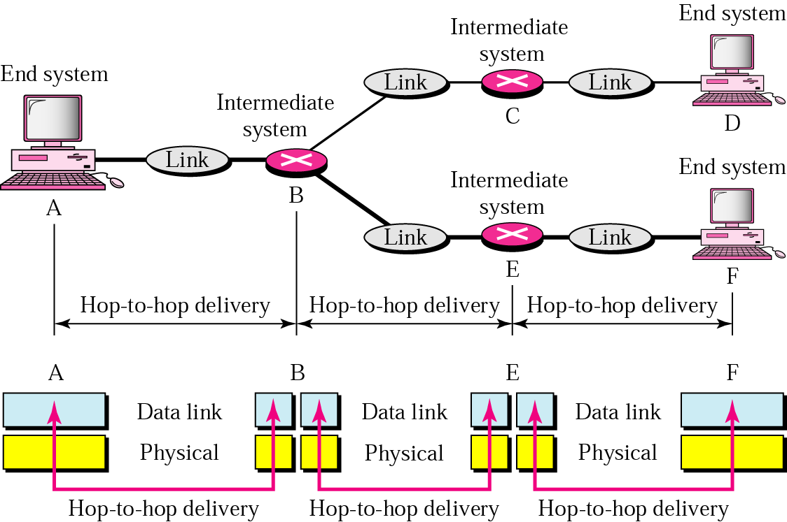
Data Link layer
- hop-to-hop delivery-

Slide 34
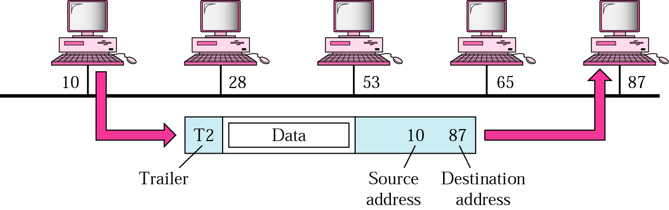
Data Link layer
- example-

Slide 35
Note
The data link layer is responsible for moving
frames from one hop (node) to the next.

Slide 36
